Slide 1


CALCULATOR APPLICATION
Vindhya Jain(B22EE078)
Khyati Sisodia(B22EE073)
Unisha Tirkey(B22CI044)
Vala Chintan Himmatbhai(B22EE069)
Sandyapaga Charan Teja(B22EE076)

Slide 2
Approach
We solve the input expression by the following series of steps:
STEP 1: Checking Syntax
STEP 2: Conversions b/w number systems
STEP 3: Condensing trig and log functions
STEP 4: Separating the expression
STEP 5: Applying BODMAS

Slide 3
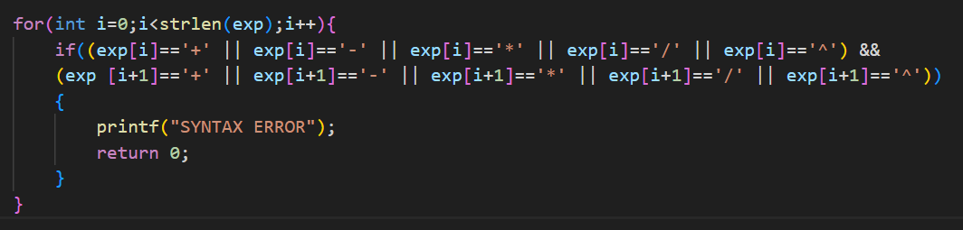
Step 1: Checking Syntax
First, we check if the input expression has the correct syntax so that it can be solved by this calculator.

Slide 4
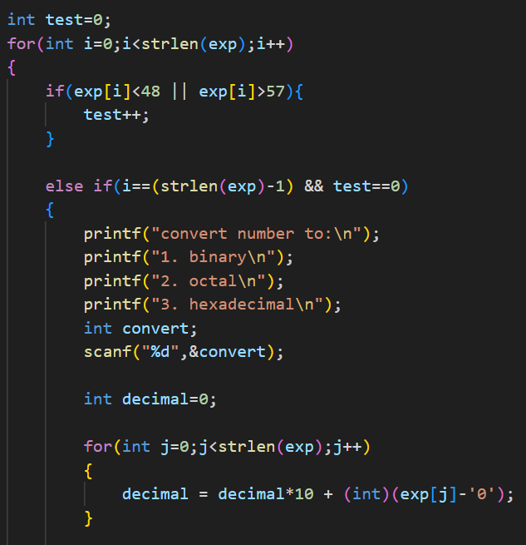
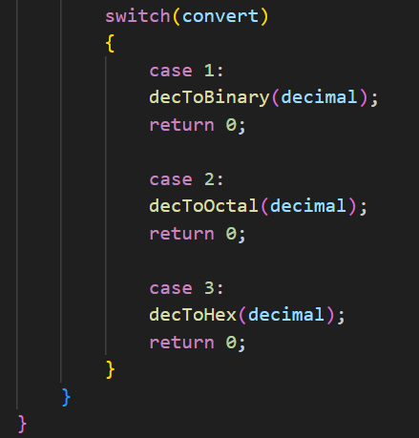
Step 2: Conversions b/w number systems
If the expression doesn’t contain any operator, the user is asked which number system they want to convert the number to.
The following conversions are supported
decimal to binary
decimal to octal
decimal to hexadecimal

Slide 5
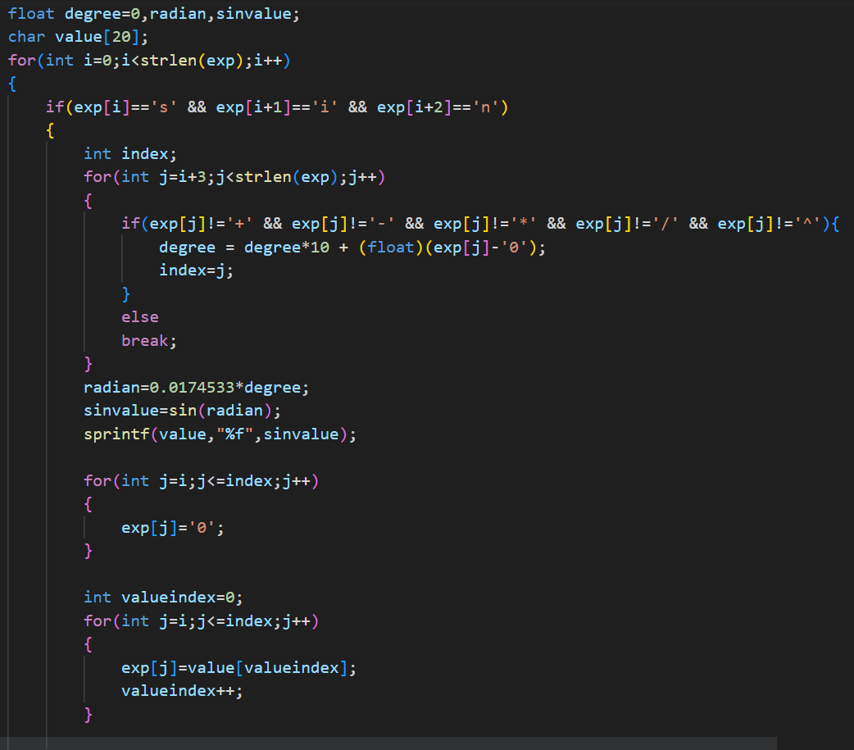
Step 3: Condensing trig and log functions
Checking the string for occurrences of trigonometric or logarithmic functions
Solving that part of the string
Changing the string by replacing the function with its numerical value
Sample Input:
2+sin45*log20-4
Modified expression
2+0.707*2.996-4

Slide 6
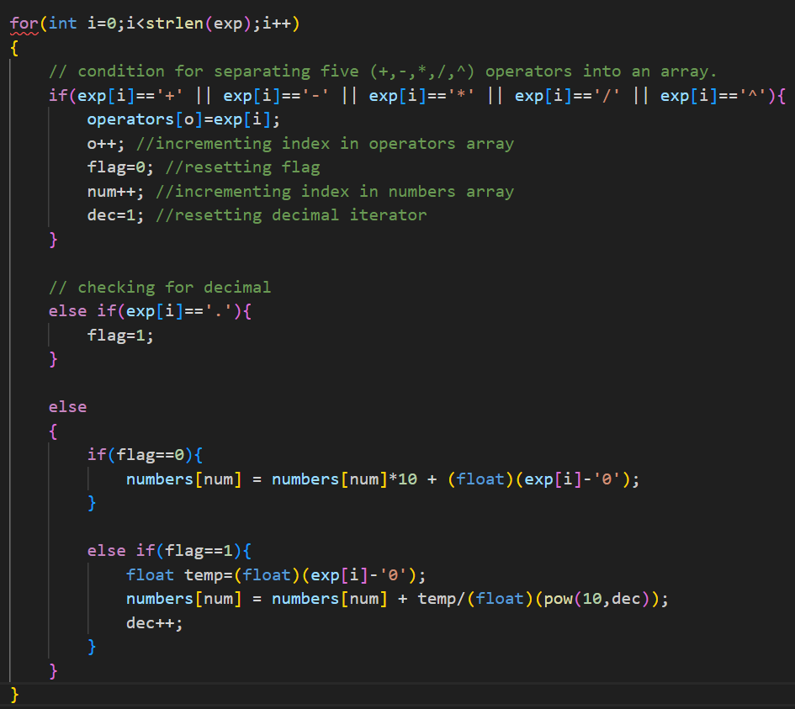
Step 4: Separating the expression
From the previous step, the expression we now have only contains the operators *,/,+,-.^.
Each number and operator appear alternatingly.
In the next step of solving, we break the expression into two arrays: (char)operators array and (float)numbers array.
Expression before this stage:
2+0.707*2.996-4
Arrays obtained:
numbers={2,0.707,2.996,4}
operators={+,*,-}

Slide 7
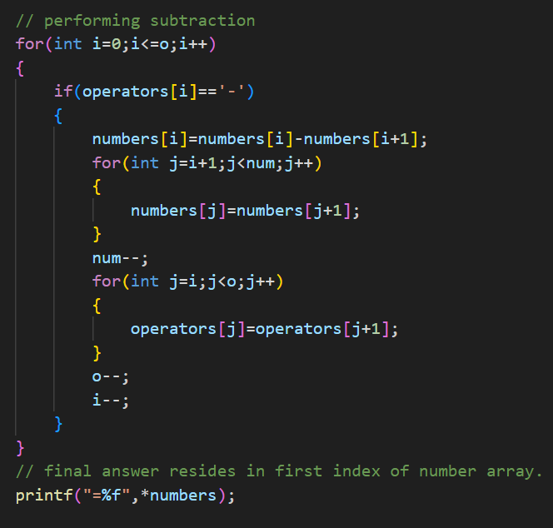
Step 5: Applying BODMAS
The operation in ith index of the operators array is performed between the ith and i+1th index of the numbers array. Then the array is rearranged.
The BODMAS rule is being followed in this process.
From the previous step:
numbers={2,0.707,2.996,4}
operators={+,*,-}
after multiplication
numbers={2,2.118,4}
operators={+,-}
2. after addition
numbers={4.118,4}
operators={-}
3. after subtraction
numbers={0.118}
operators={}
Final answer=0.118

